Slide 1
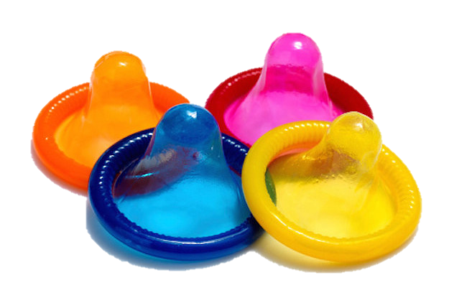
birth control
methods
Maria Camila Duran

Slide 2
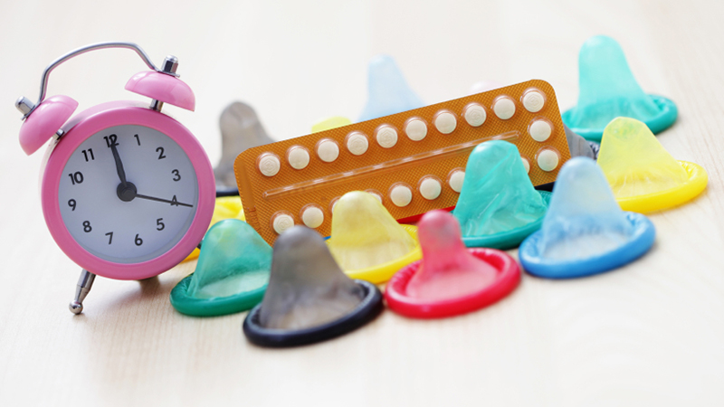
What is a birth control
methods?
Is a method or device used to prevent pregnancy

Slide 3
Why use them?
More than 1 million sexually transmitted infections (STIs) are acquired every day in the world.
There are More than 290 million women have a human papillomavirus (HPV) infection
STIs can increase the risk of HIV acquisition and in some cases, STIs can have serious reproductive health like infertility.

Slide 4
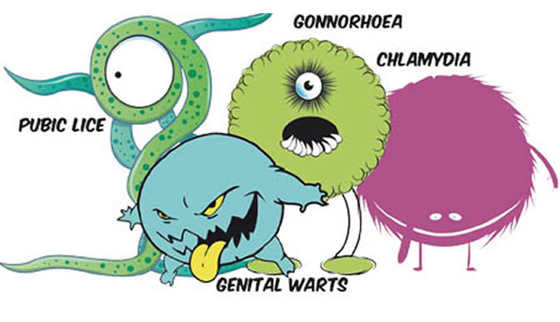

Slide 5
You can find…

Slide 7
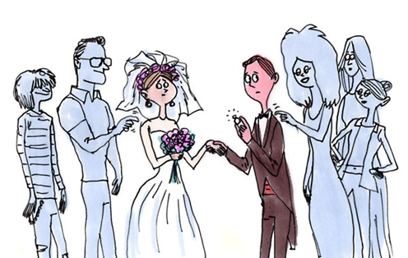
Also is very important To Know who with we're going to bed because all the sexual past of anyone Can affect us seriously.

Slide 8
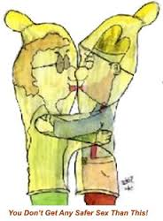
We are the owners of our bodies We choose what to do with it. And each of us must take care of it. Share our sexuality with the right person But practicing safe sex.
We are the owners of our bodies We choose what to do with it. And each of us must take care of it. Share our sexuality with the right person But practicing safe sex.

Slide 9
Birth Control Poem B rings me safety I t gives me control R ight all women should have T hat helps my acne H aving power over my body C ontraception care O ptions for everyone N o unwanted pregnancies T o regulate periods R educes cramps O ther medical benefits L ove made safe
by Rose Chloris

Slide 10
