Slide 1
¿Do you Know how the discrimination start?
LIZETH JAIMES
ASTRID PEÑA

Slide 2
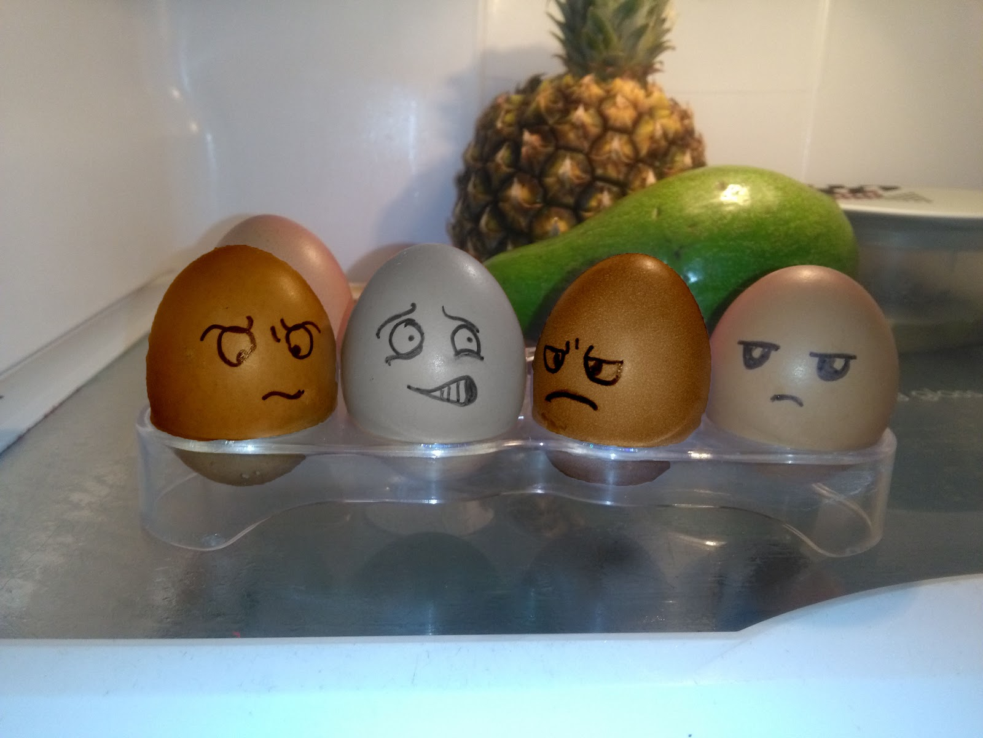
¿Do you know what is discrimination?

Slide 3
¿what is the argument that people have to discriminate against others?

Slide 4
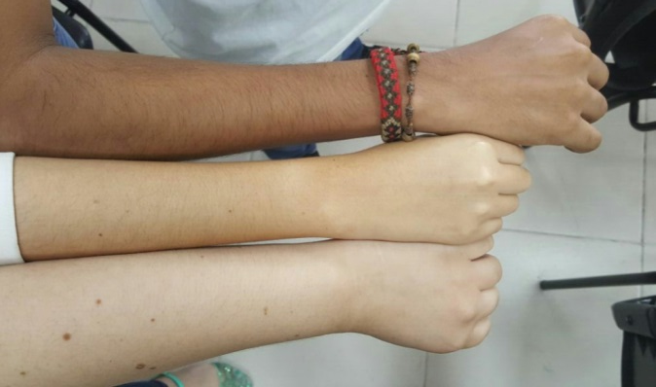
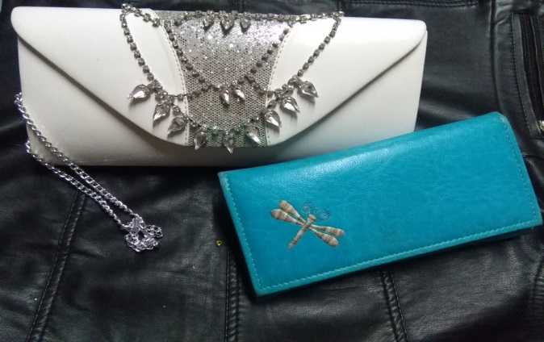
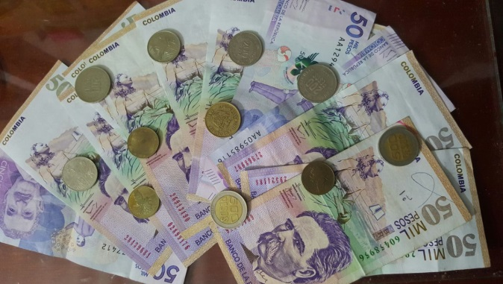
School students

Slide 5
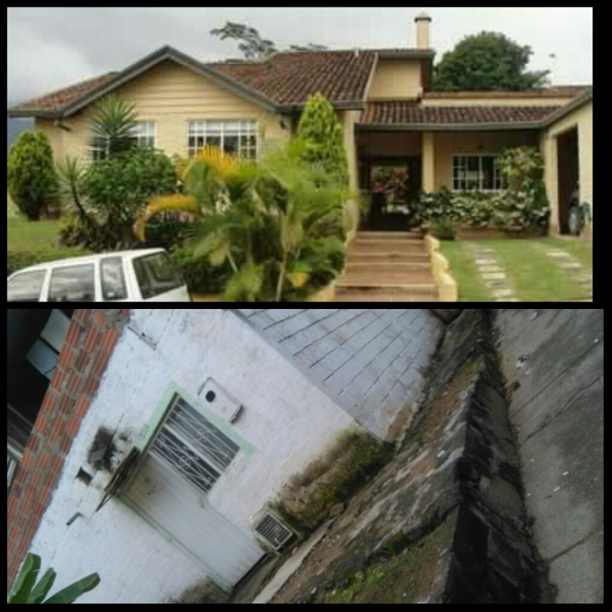
University Students

Slide 6
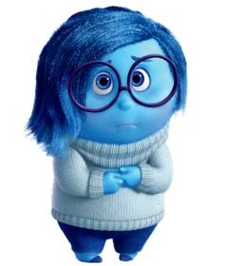
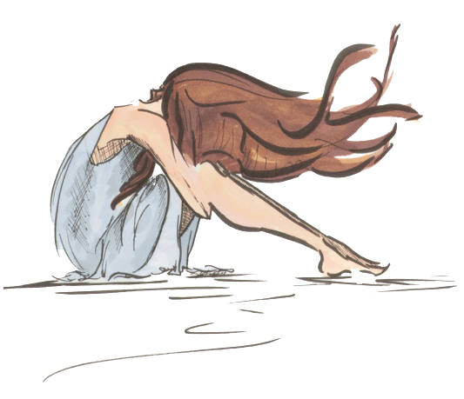
¿How do people feel when they are discriminated against?

Slide 7
THE ARGUMENT DOES NOT EXIST!

Slide 8
POEM
Everyone thinks they know how it is,
However they do not know
How they feel.
No matter if it is high,
Black or white,
No matter the money
that is the least
What do you want to make them cry?
You win grudge,
You lose dignity

Slide 9
What does it matter if he is fat,
Or skinny others?
Tell me, do you really know him?
What do they tell us all
That you have to change?
If you do not start for yourself
Where will you go?
Listen to me brother,
Listen to me,
Does teasing them
cause you pleasure?

Slide 10
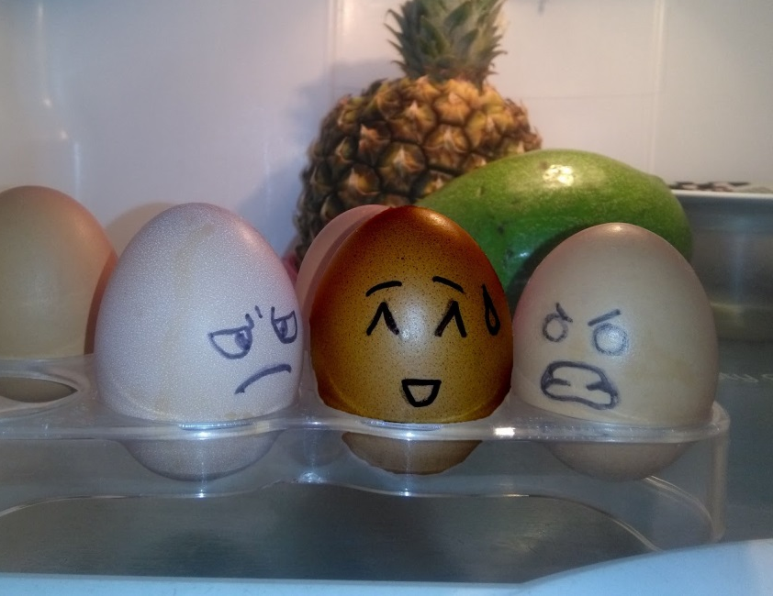
Do not discriminate, there is no argument to do …
¡THANK YOU!

